Slide 1
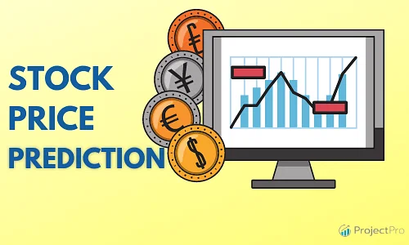
V.Lokeshwar Reddy
(20STUCHH010160)

Slide 2




AGENDA
OVERVIEW OF STOCK PRICE PREDICTION IMPORTANCE OF ACCURATE PREDICTIONS INTRODUCTION TO MACHINE LEARNING

Slide 3

WHY PREDICT STOCK PRICES?
FORECASTING FUTURE
STOCK PRICES INVESTMENT DECISION- MAKING
RISK MANAGEMENT
PROFIT OPPORTUNITIES

Slide 4


MACHINE LEARNING FOR STOCK PRICE PREDICTION
ROLE OF MACHINE LEARNING ALGORITHMS ADVANTAGES OF USING MACHINE LEARNING TECHNIQUES FOR FEATURE EXTRACTION

Slide 5
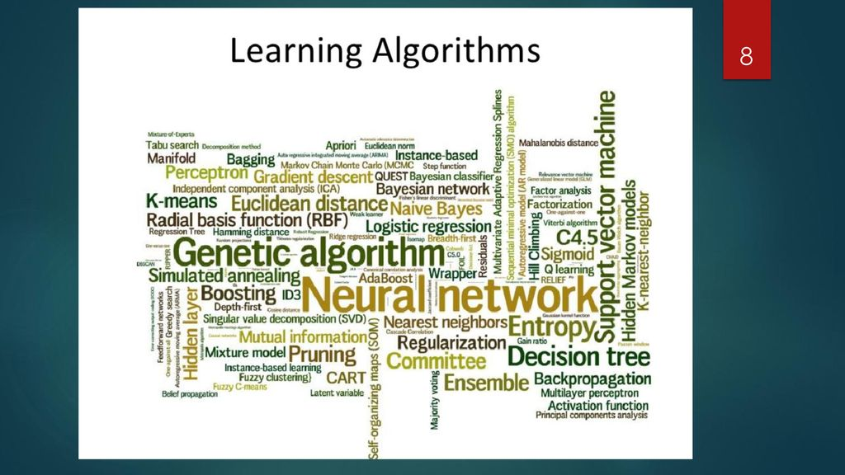

Slide 6


DATA COLLECTION AND PREPARATION
HISTORICAL STOCK DATA ECONOMIC INDICATORS NEWS SENTIMENT ANALYSIS PREPROCESSING AND ⁶C^{K}LEANING STEPS

Slide 7

MACHINE LEARNING MODELS REGRESSION MODELS: LINEAR REGRESSION, RIDGE REGRESSION,
TIME-SERIES MODELS: ARIMA,
SARIMA
ENSEMBLE MODELS: RANDOM FOREST, GRADIENT BOOSTING, XGBOOST
DEEP LEARNING MODELS:
RECURRENT NEURAL NETWORKS (RNN), LONG SHORT-TERM MEMORY (LSTM)

Slide 8




TRAINING AND TESTING SPLITTING DATA INTO TRAINING AND TESTING SETS CROSS-VALIDATION TECHNIQUES
EVALUATION METRICS (MEAN
SQUARED ERROR, ROOT MEAN SQUARED ERROR)

Slide 9

Results and Analysis
- Presenting the results of the stock price prediction model(s)
- Analyzing the accuracy and performance of the models
- Discussing the strengths and limitations of the approach

Slide 10

CONCLUSION
RECAP OF KEY POINTS DISCUSSED
IMPORTANCE OF ACCURATE STOCK PRICE PREDICTION POT⁺E¹²N^{K}TIAL FOR FURTHER RESEARCH AND IMPROVEMENT
Thank you:)

